Slide 1
Monitoring 101
for the Community Services Block Grant
March 2021

Slide 2
Agenda
Overview of CSBG Monitoring
What is Virtual Monitoring?
Virtual Monitoring Process
“Visit” Schedule
Tools & Resources
Questions & Discussion

Slide 3
Overview of CSBG Monitoring
DCF is required to assess the health of the entire agency, not just program-by-program compliance
Assessments include a combination of general oversight, desk reviews, and on-site reviews of:
Community Action Plans
Contracts
Community Needs Assessments
Service delivery systems
Administration, management, and financial systems
Strategic plans
Board and governance systems
ROMA implementation
CSBG Organizational Standards

Slide 4
Overview of CSBG Monitoring
On-site visits
Deliverables
Board rosters & meeting minutes
DCF Yearend Reports
Desk Audits
Org Standards
Community Action Plans (CSBG App)
SPARC reports
Random expense sampling
Every 3 years
After new Executive Director or CFO placement
Funding terminated for cause

Slide 5
CSBG Monitoring Principles
Mutual Respect
Joint Problem Solving
Open Communication

Slide 6
What is Virtual Monitoring?
The “new” on-site monitoring!
Will replace on-site monitoring visits for 2020 and 2021
Interviews conducted via Zoom
Document reviews conducted via secure SharePoint site

Slide 7
Virtual Monitoring Process
Agency receives a monitoring engagement memo
Pre-monitoring documents uploaded to secure SharePoint site
Monitoring introduction meeting via Zoom
DCF requests select HR, program, and financial documents for upload to SharePoint
Exit Interview with Executive Director via Zoom
DCF conducts Zoom interviews with Executive Director, key staff, and board chair over the course of one (1) week
Monitoring report & required responses
Pre-monitoring
Monitoring “visit”
Post-monitoring

Slide 8
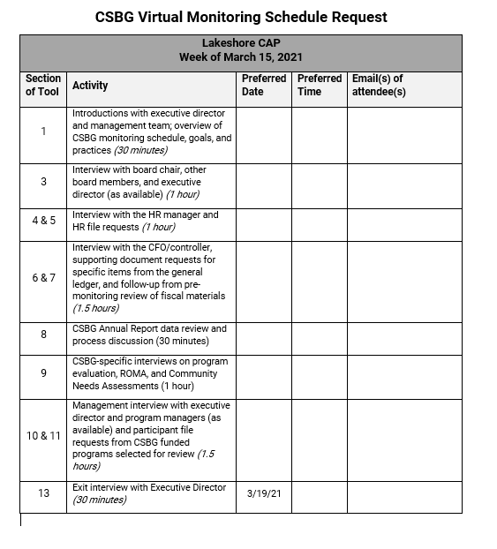
“Visit” Schedule
One week for “visit”
Complete form ahead of time for preferred Zoom interview & discussion schedule
This is our face-to-face time; the rest of the time will be for document reviews and follow-up questions via SharePoint and email
Exit interview on last day

Slide 9
Monitoring Tools & Resources
All virtual visits will follow the same CSBG Monitoring Tool, which is included as part of our CSBG State Plan and will emailed to you as part of the pre-monitoring process. This tool includes:
Monitoring Process Checklist
Pre-monitoring document checklist
Contract Compliance Checklist
Interview questions
Participant Case File Review Worksheet
Organizational Standards Assessment
Tip: Provide the Monitoring Tool to your key staff in advance of the virtual visit to help them prepare!

Slide 10
Questions & Discussion
If I don’t know, I will find out!

Slide 11
Thank you!
A copy of this presentation will be made available to you. Please send questions, comments, and requests for assistance to: Anna Sainsbury CSBG Contract Manager Department of Children and Families
anna.sainsbury@wisconsin.gov | 608.422.6270

